Slide 1
IST 565 Data Mining Tutorial on J48 algorithm in Weka

Slide 2
J48 algorithm
J48 is an implementation of the famous C4.5 algorithm to construct decision tree
J48 provides many parameters to tune.
Every time you tune a parameter, a new decision model will be created.

Slide 3
Use J48 in Weka
Two key questions:
How to tune parameters to get better models?
How to evaluate which model is the best?

Slide 4
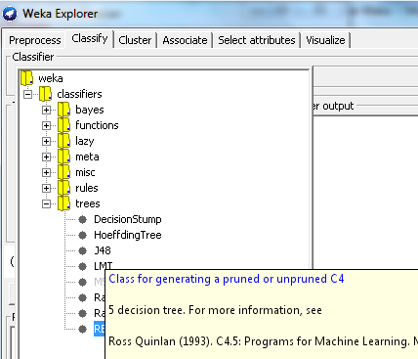
How to tune parameters to get better decision tree models?
Step 1: find J48 algorithm, located in the “Classify” tab, under “trees”

Slide 5
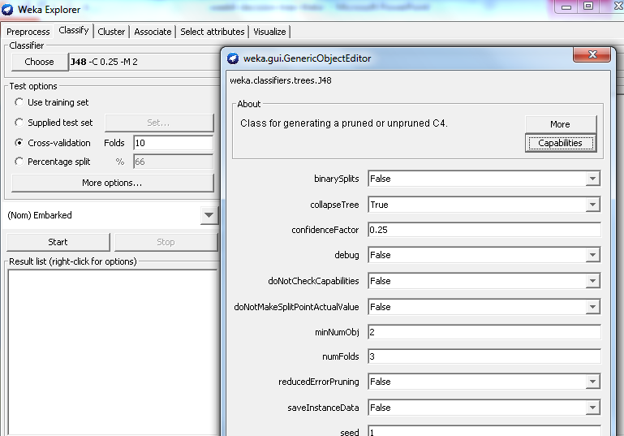
J48 parameter panel
Click the algorithm (in red box) to pop up the parameter panel

Slide 6
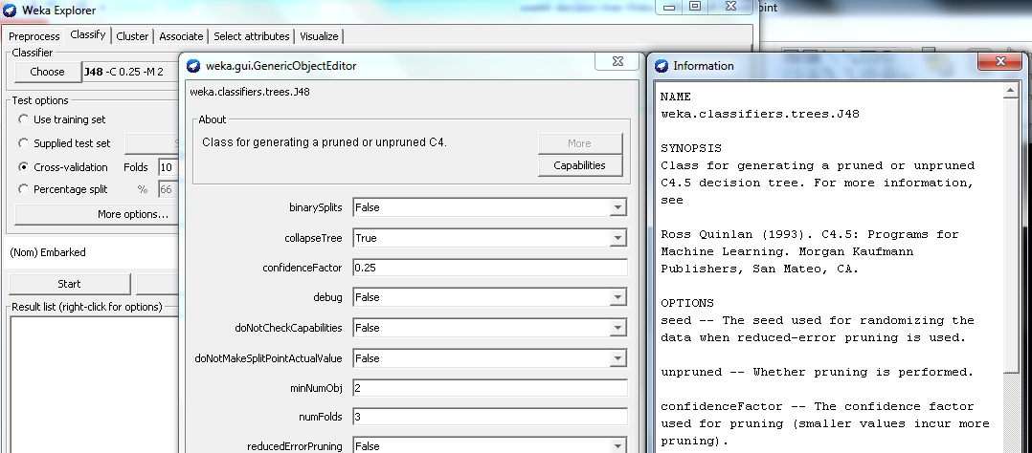
J48 Parameter Meaning
Click the “more” button (in red box) to pop up the explanation for the parameters

Slide 7
J48 Parameters
Tuning these parameters requires the theoretical knowledge of their purpose and empirical knowledge of their performance on different kinds of data.
Several important parameters to tune
“BinarySplit”: True or False
True: a deep tree with two branches at each level
False (default): a wide tree with many branches at each level
Which one works better: depend on data

Slide 8
J48 Parameters
“unpruned”: True or False
True: grow a tree completely without pruning
False (default): prune the tree
“ConfidenceFactor”: numeric (0 to 1)
Decide how aggressive to prune the tree
Smaller values incur more pruning
Too aggressive results in a too small tree that does not capture all patterns.
Too conservative results in a large tree that overfits the training data
How to find the balance point?
Use good evaluation method, such as cross validation (in later slides)

Slide 9
J48 Parameters
“minNumObj”: integer (1 to inf)
The minimum number of examples in the leaf node
Default value: 2
It means all leaves with only one data example are pruned
Increase this value would result in more aggressive pruning

Slide 10
J48 Parameters
Further techniques to prune a tree
“reducedErrorPruning”: replace a subtree with a leaf node with the most popular category label
“subtreeRaising”: a subtree replaces its parent
Notes:
Split the data to training and validation set, train a model, prune and test on validation data

Slide 11
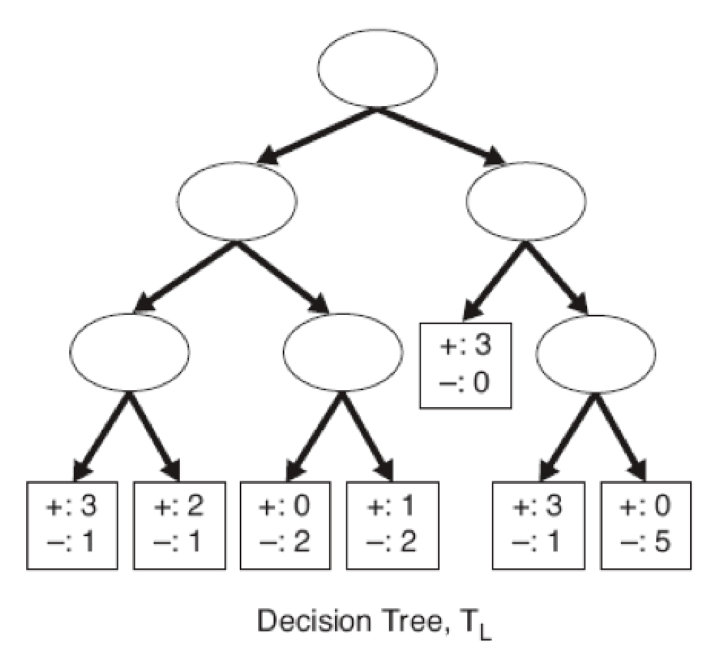
ReducedError Pruning
+:5
-:2
Notes:
Which node to prune depends on which one can reduce error to the greatest after replacement

